Slide 1
Chapter 4 Relational Database

Slide 2
Concept of a Relational Database
4.1
In the previous chapters, the databases we learnt to manage were all relational databases.
A relational database organises data in a tabular form. A table consists of columns and rows. Each row is a record.

Slide 3
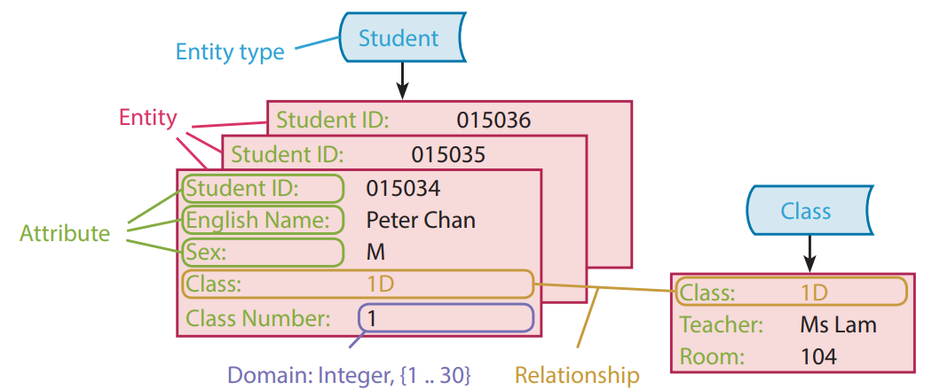
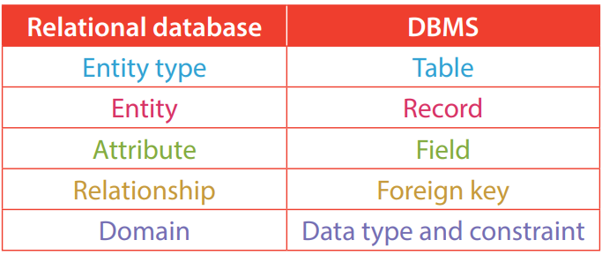
Concept of a Relational Database
4.1
The elements of a relational database are usually stored as or represented by different elements in a Database Management System (DBMS).

Slide 4
Entity
A
An entity is either:
a physical object, such as a building, a product or a student or an employee; or
a conceptual object, such as an organisation, a transaction, a course or a job.
An entity must be unique, meaning that we should always be able to differentiate between two entities.

Slide 5
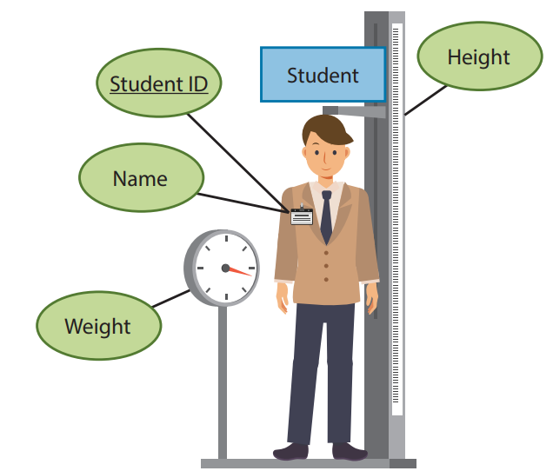
Entity
A
An entity type is a collection of entities sharing similar attributes. For example, a specific student can be an entity and a collection of students from the same school is an entity type.

Slide 6
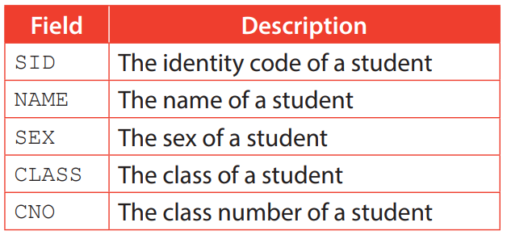
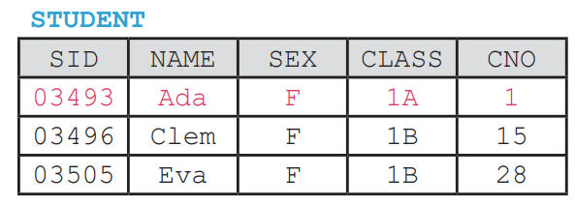
Entity
A
In the table below, students are an entity type and a single student (e.g. Ada) is an entity

Slide 7
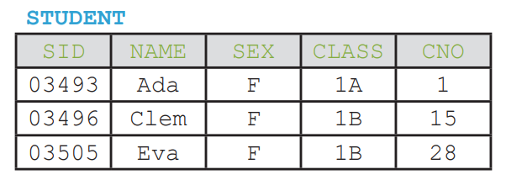
Attribute
B
An attribute is the property of an entity. An entity can have multiple attributes.
In the table STUDENT mentioned in the previous section, the name (NAME) and the sex (SEX) of a student are attributes of the entity type, students (STUDENT).

Slide 8
4.1
Finish Activity 4.1 on P. 205 of your textbook.
2. C

Slide 9
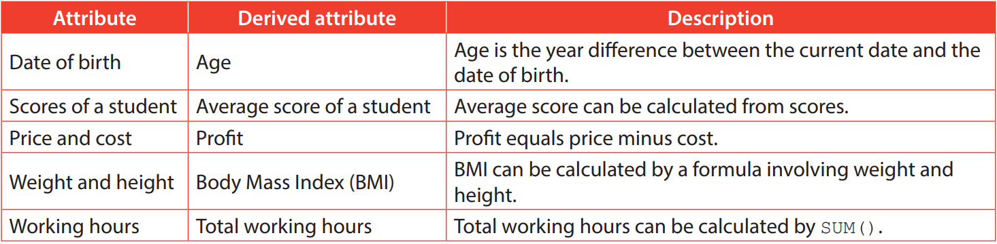
Attribute
B
Some attributes can be derived from other attributes. They are called derived attributes. For example:

Slide 10
Relationship
C
A relationship is the connection between entities.
For example, there are two entity types, students and clubs. A student may join one of the clubs. Thus, “join” is the relationship between these two entity types.

Slide 11
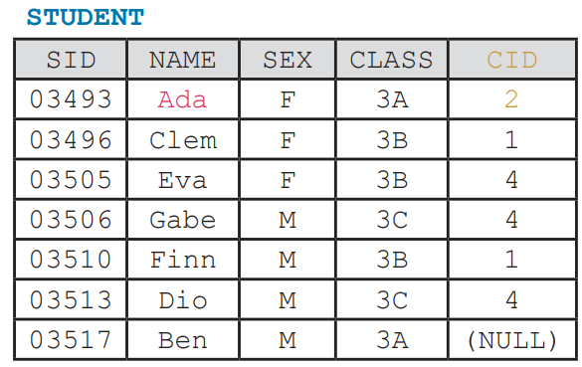
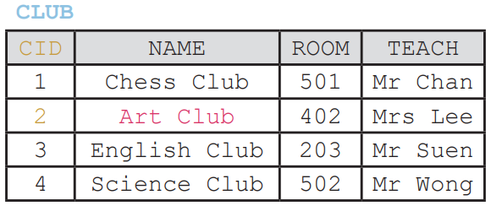
Relationship
C
See the following tables:
STUDENT references the CLUB by using CID. For example, student Ada has a CID of 2, which means she joined Art Club according to the data in CLUB.

Slide 12
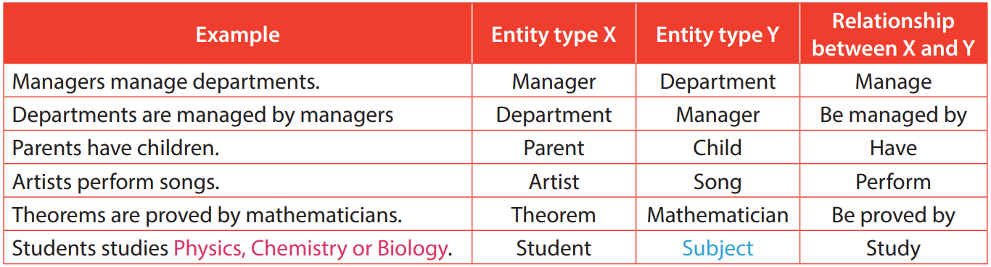
Relationship
C
Pay attention to the use of active voice and passive voice.
Moreover, we should NOT treat specific entities as entity types. For example, an entity type should NOT be a particular subject like Physics or Chemistry, but subjects as a whole.

Slide 13
4.2
Finish Activity 4.2 on P. 207 of your textbook.
2. A

Slide 14
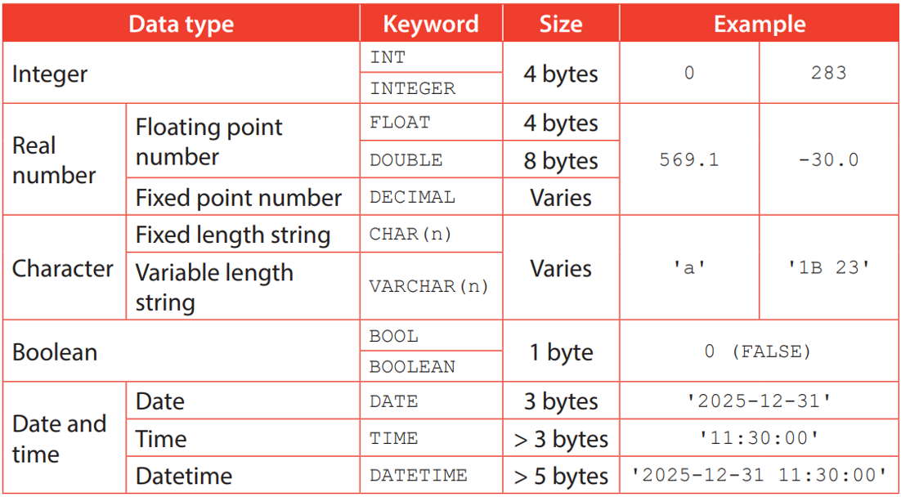
Domain
D
A domain of an attribute is the set of all available values. The values in a domain always share the same data type.

Slide 15
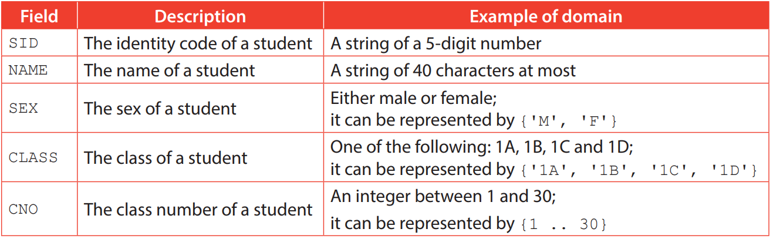
Domain
D
Examples of domain:

Slide 16
4.3
Finish Activity 4.3 on P. 209 of your textbook.
2. C

Slide 17
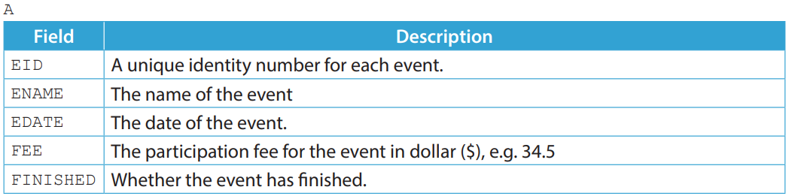
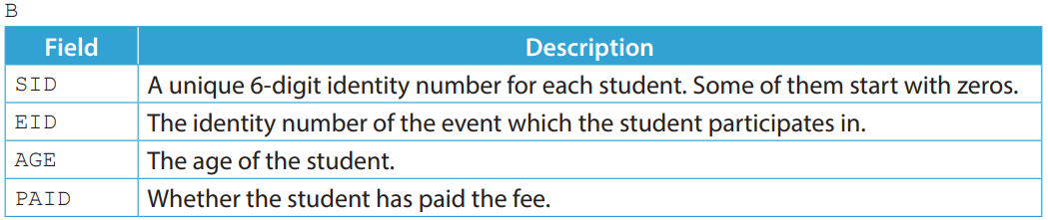
4.1
1. A secondary school teacher created two tables A and B to store the data of school events and student participants. The age of the students ranges from 11 to 18 years old.

Slide 18
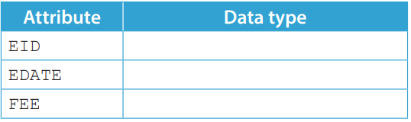
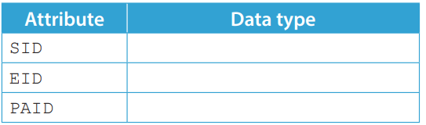
4.1
(a) State the entity types of A and B. (b) Suggest a data type for each of the following attributes in A.
(c) Suggest a data type for each of the following attributes in B.

Slide 19
4.1
(d) What is the domain of AGE?
(e) What is the relationship between the entity types of A and B?

Slide 20
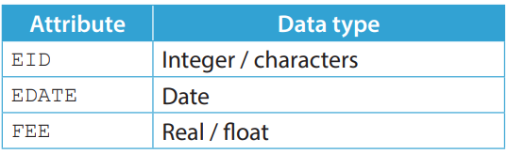
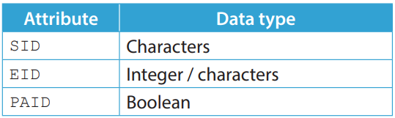
4.1
◣ Solution
(a) School events and students respectively.
(b)
(c)

Slide 21
4.1
(d) {11 .. 18}
(e) B participates in A.

Slide 22
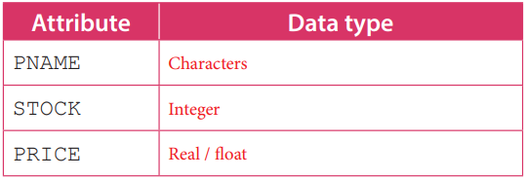
4.1
Finish Checkpoint 4.1 on P. 211 of your textbook.
(a) Products and shops respectively.
(b)
(c) BHOUR is a derived attribute. It is the hour difference / time range between OPEN and CLOSE.
(d) {00:00 .. 23:59}
(e) B sells A / A is sold by B.

Slide 23
Schema
4.2
A database schema is a text string that describes a database table.

Slide 24
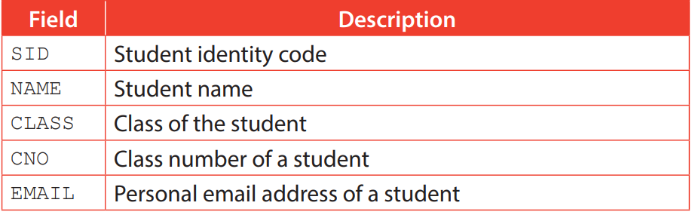
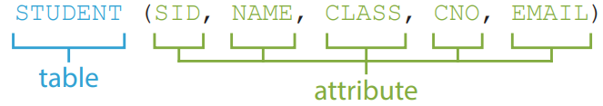
Schema
4.2
For example, here is the table structure of the table STUDENT.
The schema for this table can be written as:

Slide 25
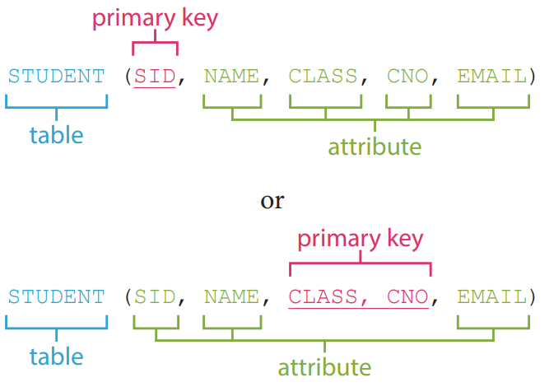
Schema
4.2
The primary key of a table is often underlined in the schema, for example:

Slide 26
Key fields
A
To distinguish between records in a database table, there must be key fields. Different types of key fields serve for different purposes.

Slide 27
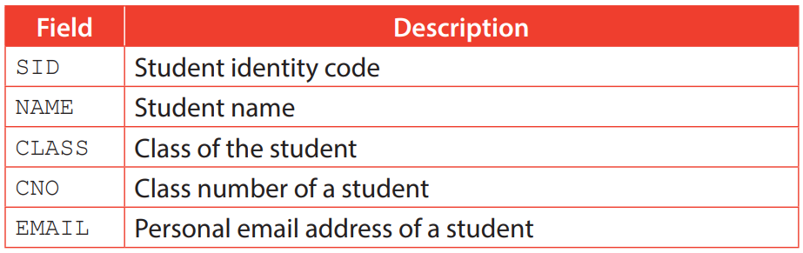
Key fields
A
A candidate key is a key field that always stores unique data for every record. Therefore, a candidate key can be used to identify records.
In the above table, the field SID stores unique data for every record. Therefore, it is a candidate key for the table STUDENT

Slide 28
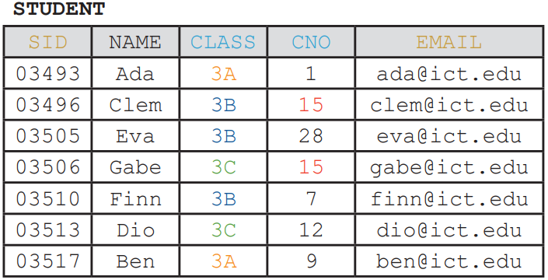
Key fields
A
Sometimes, a candidate key may consist of more than one field. This type of candidate key is called composite key.
In the table STUDENT, CLASS+CNO is a composite key since it is impossible for two students to share the same class and the same class number at the same time.

Slide 29

Key fields
A
A composite key must be minimal, meaning that the removal of any field within the key results in duplicated values.
CLASS+CNO is a composite key as the removal of either CLASS or CNO results in duplicated values.

Slide 30
4.4
Finish Activity 4.4 on P. 216 of your textbook.
2. A

Slide 31
Key fields
A
The primary key of a table must be one of the candidate keys of that table. It is a candidate key chosen by the database administrator to identify records.
A table can have multiple candidate keys, but it can have one primary key only.

Slide 32
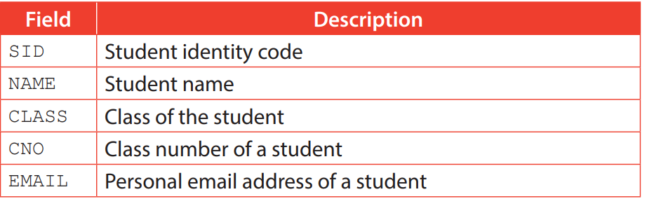
Key fields
A
Below is the table structure of STUDENT:
For the table STUDENT, we have three candidate keys: SID, EMAIL and CLASS+CNO.

Slide 33
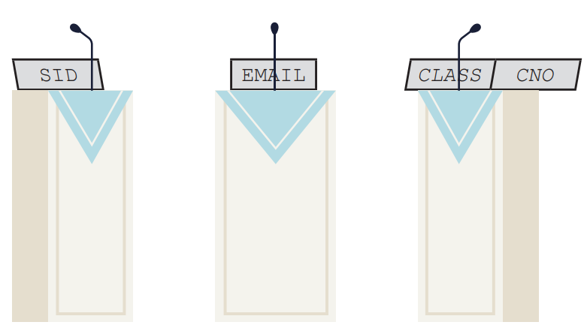
Key fields
A
However, only one of them can be the primary key of the table STUDENT.

Slide 34
Key fields
A
EMAIL is not the best primary key as a student may change their personal email address for reasons such as forgetting the password of the email address and the deactivation of the email address.
Which one, SID or CLASS+CNO, would you choose to be the primary key? Explain briefly.
SID, as the CLASS+CNO of a student usually changes every year while SID does not.

Slide 35
Key fields
A
Foreign keys are used to show the relationship between records in two tables.
A foreign key in a table X is always the primary key of another table Y.
In such case, table X is referred to as the host table and table Y is referred to as the parent table.

Slide 36
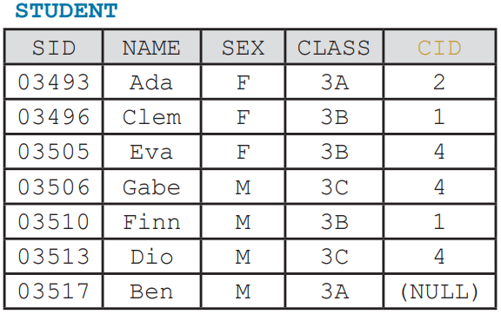
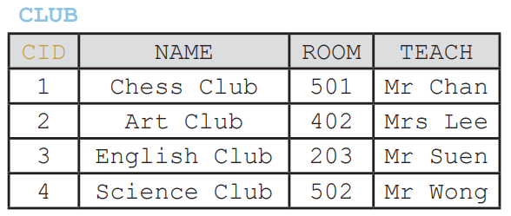
Key fields
A
The CID field in table STUDENT is a foreign key that links the host table STUDENT to the parent table CLUB.

Slide 37
Key fields
A
Using a foreign key allows us to manage the data better. For example:
When the name, room or teacher of a club is updated in the table CLUB, we do not have to update the table STUDENT as STUDENT stores the identity code of a club only; and
Even if the records of all students who join a certain club are deleted in table STUDENT, the data of this club will be kept in table CLUB.

Slide 38
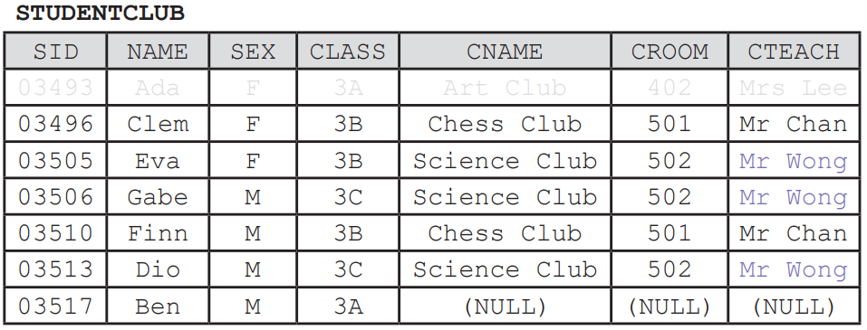
Key fields
A
Imagine the data of students and clubs are stored in the same table.
If the teacher of Science Club is changed from Mr Wong to Mr Suen, three records needs to be updated or the data will be inconsistent; and
If the only student in Art Club, i.e. Ada, quits the school, the data of Art Club will be lost.

Slide 39
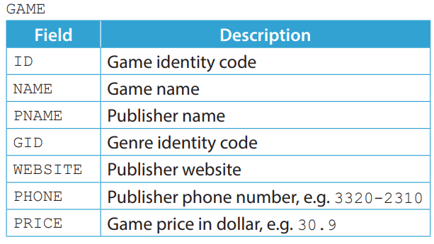
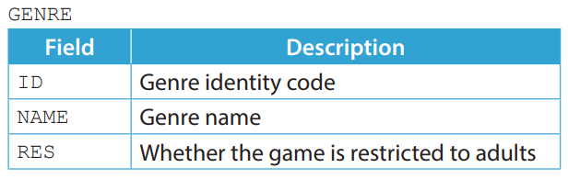
4.2
1. A video game distribution platform uses two tables GAME and GENRE to manage the data of games.

Slide 40
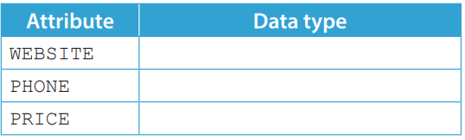
4.2
(a) Write the schemas of GAME and GENRE. Underline the primary keys of the tables and state the foreign keys if any.
GAME (________________________________________)
Foreign key: ____________
GENRE (________________________________________)
Foreign key: ____________
(b) Suggest a data type for each of the following attributes in GAME.

Slide 41
4.2
(c) The database administrator creates a table PUBLISHER to store the data of publishers and assigns an identity code for each publisher.
This identity code will be used as a foreign key in GAME. Data that relates to publishers other than the publisher identity code should be removed from GAME.
Write the updated schema of GAME and the schema of PUBLISHER. Underline the primary keys of the tables and state the foreign keys if any.
GAME (________________________________________) Foreign key: ____________
PUBLISHER (________________________________________) Foreign key: ____________

Slide 42
4.2
(d) A publisher wants to hold a sale promotion by giving a discount on all the games they published. Different games may have different discount. This discount will last for two weeks.
Instead of updating the field PRICE, the database administrator suggests adding a new field named DISCOUNT and using its values to calculate the final price of games. State one advantage of this approach.

Slide 43
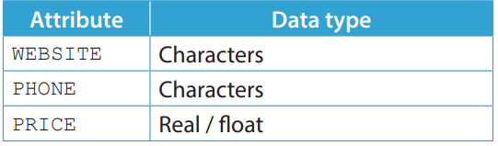
4.2
◣ Solution
(a) GAME (ID, NAME, PNMAE, GID, WEBSITE, PHONE, PRICE) Foreign key: GID GENRE (ID, NAME, RES) Foreign key: N/A
(b)

Slide 44
4.2
(c) GAME (ID, NAME, PID, GID, PRICE)
Foreign key: PID, GID
PUBLISHER (ID, NAME, WEBSITE, PHONE)
Foreign key: N/A
(d) After two weeks, the administrator can set DISCOUNT of the games published by the mentioned publisher to 0 to change their prices back to the original prices.

Slide 45
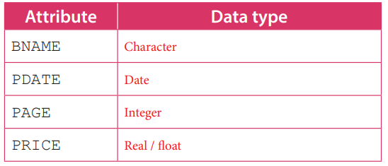
4.2
Finish Checkpoint 4.2 on P. 221 of your textbook.
(a) BOOK(ISBN, BNAME, ANMAE, ANAT, AAGE, DATE, PAGE, PRICE, PID ) Foreign key: PID PUBLISHER (PID, PNAME, PHONE, LOCATION ) Foreign key: N/A
(b)

Slide 46
(c) BOOK (ISBN, BNAME, AID, DATE, PAGE, PRICE, PID ) Foreign key: AID, PID
AUTHOR (AID, ANAME, ANAT, AAGE ) Foreign key: N/A
(d) The age of a person changes while their birthday does not. Thus, if birthdays are stored, we do not have to update the data frequently. Instead, we can simply calculate the ages of authors by using their birthdays.

Slide 47
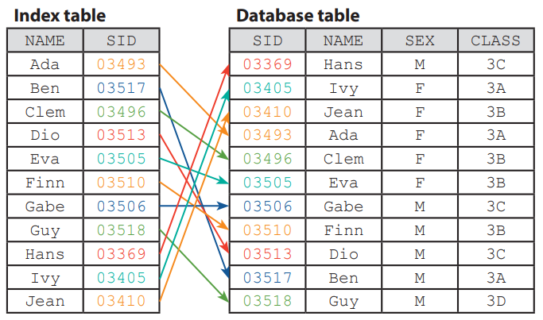
Index
B
When a field is expected to be searched frequently, we can index that field to speed up the data retrieval process.
Indexing a field creates an index table containing the indexed field and a pointer to the related records only.

Slide 48
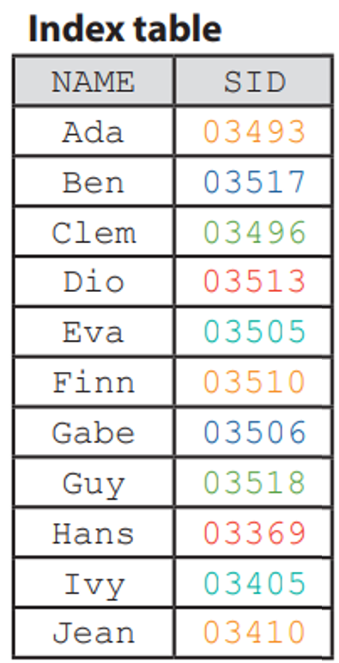
Index
B
However, the DBMS needs to update the index table if changes are made to the data in the indexed field or a new record is added.
It takes time for the DBMS to update and storage space to store the index table. Therefore, it is wise to index a field only if necessary.

Slide 49
4.5
Finish Activity 4.5 on P. 224 of the textbook.
1. 3
2. 4; Hamlet, or other reasonable answer.
3. log2 1000 = 9.97 ∴ it has to search 10 times in the worst case.

Slide 50
Integrity
4.3
When we update the data in a DBMS, the integrity of data may be affected, meaning that the data is no longer accurate or valid.
Here are three aspects of integrity that we should pay attention to:
Entity integrity
Referential integrity
Domain integrity

Slide 51
Entity integrity
A
Entity integrity means that:
a table must have its primary key defined; and
the primary key for each record is unique and not NULL.
When using a DBMS, it is important to define a primary key for a table.
Once the primary key is defined, the DBMS will ensure that the primary key for each record is unique and not NULL.

Slide 52
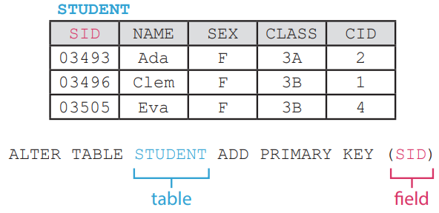
Entity integrity
A
See the following table:
If SID is set as the primary key, you will NOT be able to:
insert a new record with an SID of 03493 or update a record to have an SID of 03493 since this SID is already occupied by the student Ada; or
insert a new record without SID since the primary key for a record cannot be NULL.

Slide 53
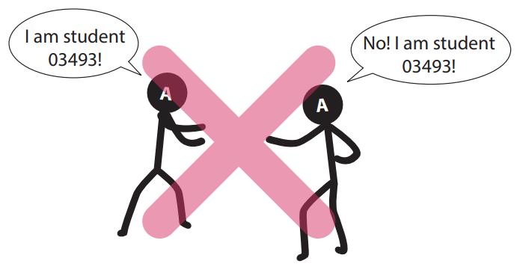
Entity integrity
A
A table violates entity integrity if:
it does not have a primary key;
its primary key contains duplicated values; or
its primary key contains a NULL value.

Slide 54
Referential integrity
B
Referential integrity means that the references of foreign keys in a table are valid so that its relationship with other tables remains intact.
Once the foreign key is defined, the DBMS will ensure that the values of foreign key for each record must come from the values of the field it references. It does not stop a record to have NULL as the value of a foreign key though.

Slide 55
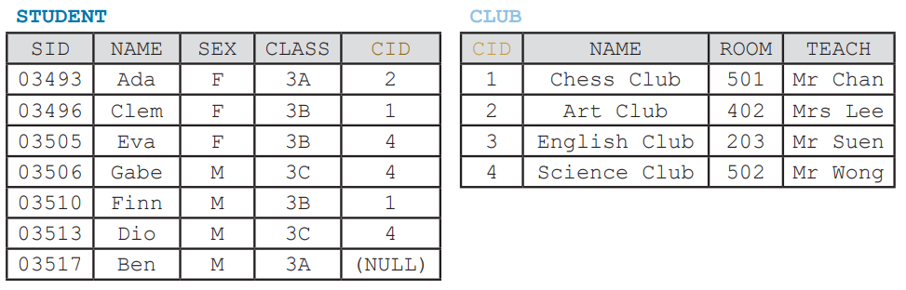
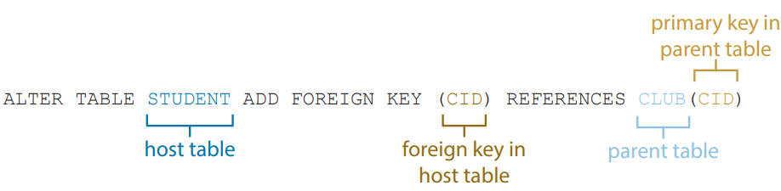
Referential integrity
B
See the following tables:

Slide 56
Referential integrity
B
Assume that CLUB.CID is the primary key of the table CLUB and STUDENT.CID is the foreign key of the table STUDENT which links to CLUB.CID.

Slide 57
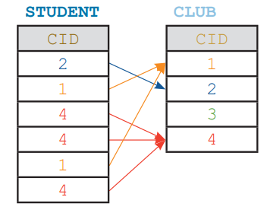
Referential integrity
B
Excluding NULL values, each foreign key value (CID) in the host table (STUDENT) must come from the primary key value (CID) in the parent table (CLUB).

Slide 58
Referential integrity
B
Thus, the DBMS prevents actions that would cause a foreign key value (CID) in the host table (STUDENT) to reference a primary key value (CID) that does not exist in the parent table. It means you will NOT be able to:

Slide 59
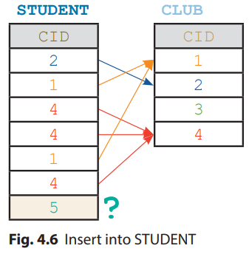
Referential integrity
B
Insert a new record into STUDENT with a CID that does not exist in CLUB;

Slide 60
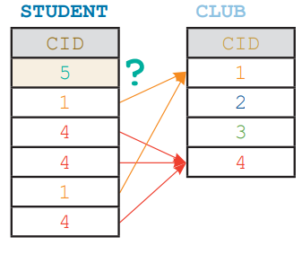
Referential integrity
B
Update a record in STUDENT to have a CID that does not exist in CLUB;

Slide 61
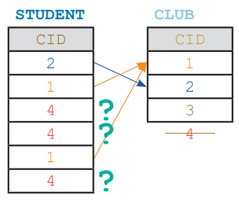
Referential integrity
B
Delete a record from CLUB with a CID that is referenced by STUDENT; and

Slide 62
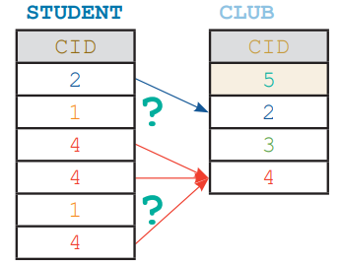
Referential integrity
B
Update the CID of a record in CLUB that is referenced by STUDENT to a new value.

Slide 63
Domain integrity
C
Domain integrity means that the value of an attribute must fall within a reasonable domain.
When using a DBMS, we may define the domain of an attribute by setting its data type and constraints.

Slide 64
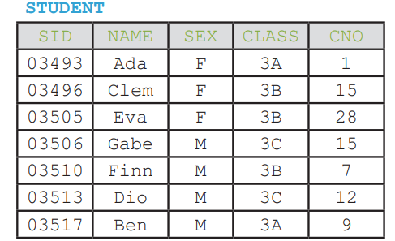
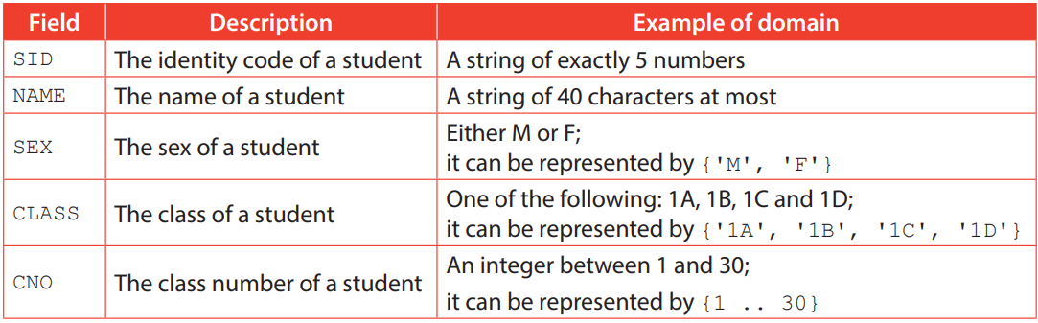
Domain integrity
C
See the following table:

Slide 65
Domain integrity
C
CREATE TABLE STUDENT ( SID CHAR(5) PRIMARY KEY, NAME VARCHAR(40), SEX CHAR(1), CLASS CHAR(2), CNO INT, CHECK (LENGTH(SID) = 5), CHECK (SEX IN ('M', 'F')), CHECK (CLASS IN ('1A', '1B', '1C', '1D')), CHECK (CNO BETWEEN 1 AND 30) )

Slide 66
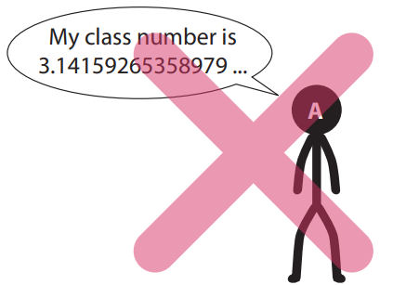
Domain integrity
C
If the data types and constraints of the mentioned attributes are defined as above, you will NOT be able to:
insert a new record with an SID of less than 5 characters; or
update a record to have a CLASS other than 1A, 1B, 1C and 1D; or
insert a new record with a CNO of One; or
update a record to have a CNO of –6.
A table violates domain integrity if its field contains a value that is not within its domain.

Slide 67
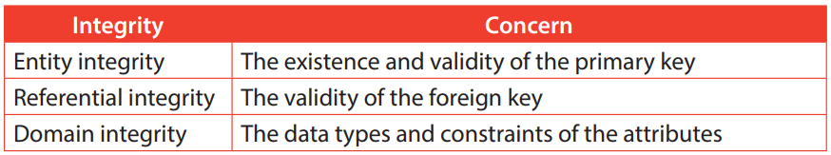
Domain integrity
C
In summary, each integrity concerns a different issue:

Slide 68
4.6
Finish Activity 4.6 on P. 230 of your textbook.
2. D

Slide 69
4.3
Finish Checkpoint 4.3 on P. 232 of your textbook.
(a) Domain integrity. The closing hour of Kenneth Fish & Chip is 20:90, which is an invalid value.
(b) Entity integrity.
(c) ADDRESS. No two shops share the same address.
(d) The records of all products that are sold at the removed shop should be removed as well.

Slide 70
Rollback
4.4
A rollback means restoring a database to its previous state.
When managing a database, errors may occur and corrupt the integrity of data. Therefore, we must make a backup of our database regularly. When needed, we can roll back our database using the backup.

Slide 71
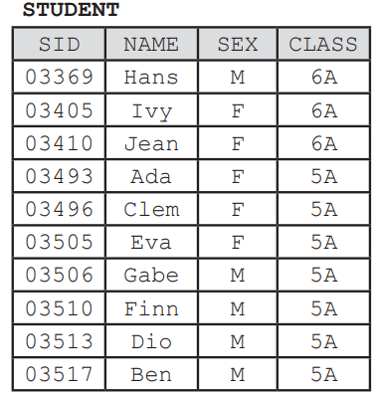
Rollback
4.4
See the following table:
A new school year is coming soon, a teacher wants to:
1. delete students in class 6A; and
2. promote all students in class 5A to class 6A.

Slide 72
Rollback
4.4
It means two SQL statements are needed:
DELETE FROM STUDENT WHERE CLASS = '6A'
UPDATE STUDENT SET CLASS = '6A' WHERE CLASS = '5A‘
However, they mess up the order of operations. Now all 5A students are promoted to 6A, then all 6A students are deleted, leaving the table empty.
This is where we need a rollback.

Slide 73
4.4
Finish Checkpoint 4.4 on P. 236 of your textbook.
(a) PAYMENT ( TID, PAYERID, PAYEEID, AMOUNT, TTIME ) Foreign key: PAYERID, PAYEEID
(b) The deposit of the payer account is subtracted by the amount of the payment; and The deposit of the payee account is added by the amount of the payment.
(c) Rollback the database to the previous state. It is possible that some of the payments are halfway through the process, e.g. the deposit of the payer account is subtracted but the deposit of the payee is not added.

